Slide 1
《英语国家社会与文化入门》(下册）
The Society and Culture
of Major English-Speaking Countries
An Introduction
(Book Two)

Slide 2
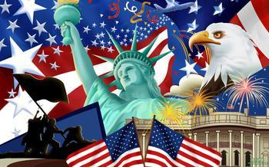
The United States of America
Unit 3 American Beginnings

Slide 3
Quiz
Give the English and a brief explanation for the following:
1 马丁· 路德
2 哥伦布
3 清教徒
4 五月花公约
5 波士顿倾茶事件

Slide 4
Focal Points
The discovery of the Americas
The Three forces that led to the development of Europe and the English permanent settlements in North America
The four colonial patterns in North America
-Jamestown, Virginia
-Puritan New England
-Catholic Maryland
-Quaker Pennsylvania
The American Revolution

Slide 5
This Unit Is Divided into Four Sections
The Discovery of the Americas
II. The Three Forces that Led to the Development of Europe and the English Permanent Settlements of Europeans in North America
III. The Four Colonial Patterns in North America
IV. The American Revolution

Slide 6
I. The Discovery of the Americas
The first long-continuing immigration movement to the Americas from Asia began probably 25000 years ago, and Siberian tribes crossed over the Bering Strait to Alaska, mistakenly called Indians
(The second immigration movement from Europe began with the expansion of Europe from the 16th century)

Slide 7
Christopher Columbus and John Cabot
In 1492 Christopher Columbus, sailing from Spain, landed on one of the Bahamas Islands in the Caribbean Sea and “discovered” the New World.
In 1497 John Cabot arrived in today’s Canada; The English king claimed that North America belonged to England.

Slide 8
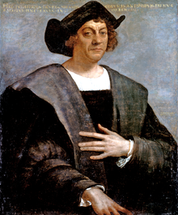
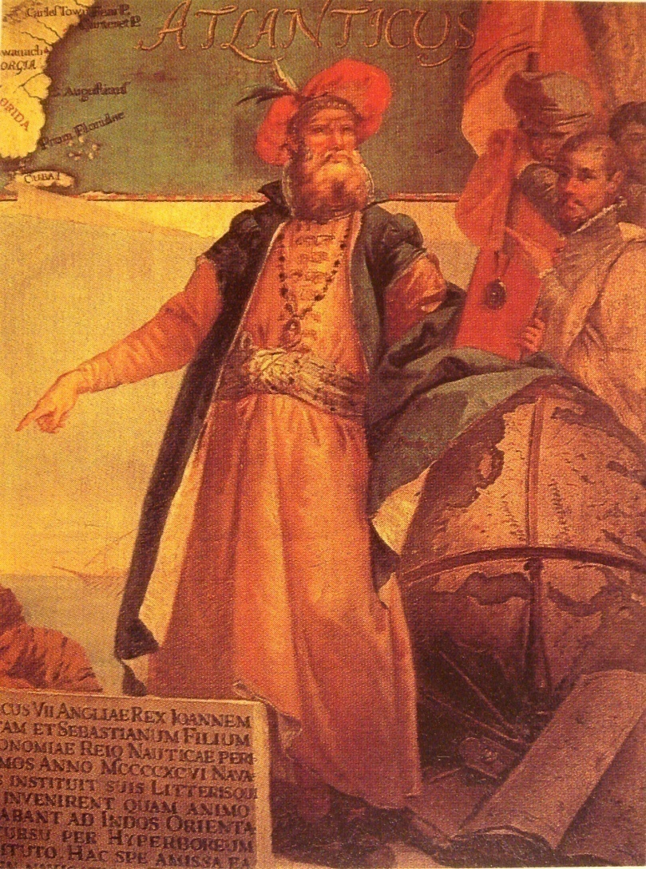
Christopher Columbus (left) and John Cabot (right)

Slide 9
II. The Three Forces that Led to the Development of Europe and the English Permanent Settlements of Europeans in North America
A. The development of capitalism in the 16th and 17th centuries and growth of the bourgeoisie and working class

Slide 10
II. The Three Forces that Led to the Development of Europe and the English Permanent Settlements of Europeans in North America
B. The Renaissance (from the mid 14th to the end of the 16th century
God-centered world challenged;
authority of the Bible challenged;
changing outlook on life;
the burst of creativity in the fine arts;
flourishing in the literary sphere;
expansion of scientific and philosophical horizons

Slide 11
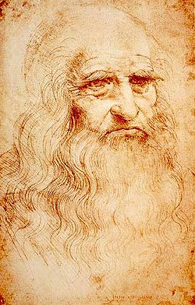
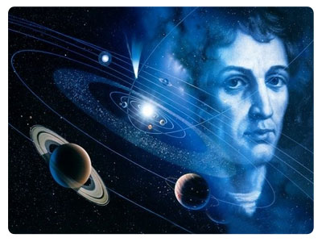
Renaissance
Leonardo da Vinci
Nicolaus Copernicus

Slide 12
II. The Three Forces that Led to the Development of Europe and the English Permanent Settlements of Europeans in North America
C. The Religious Reformation (or Protestant Reformation)
Martin Luther and John Calvin
They believed that sinful men could only win salvation by faith in Jesus Christ;
They believed that Bible was the only true guide to the will of God;
They challenged the authority of the Pope and the Catholic Church;
They believed in establishing a direct contact with God

Slide 13
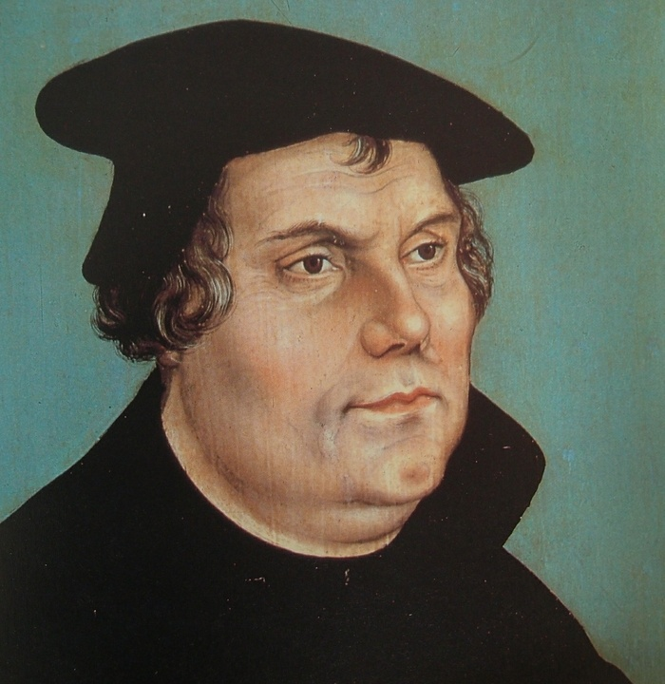
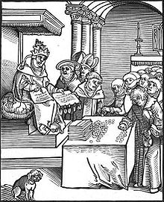
The Religious Reformation
Martin Luther
Church selling indulgences

Slide 14
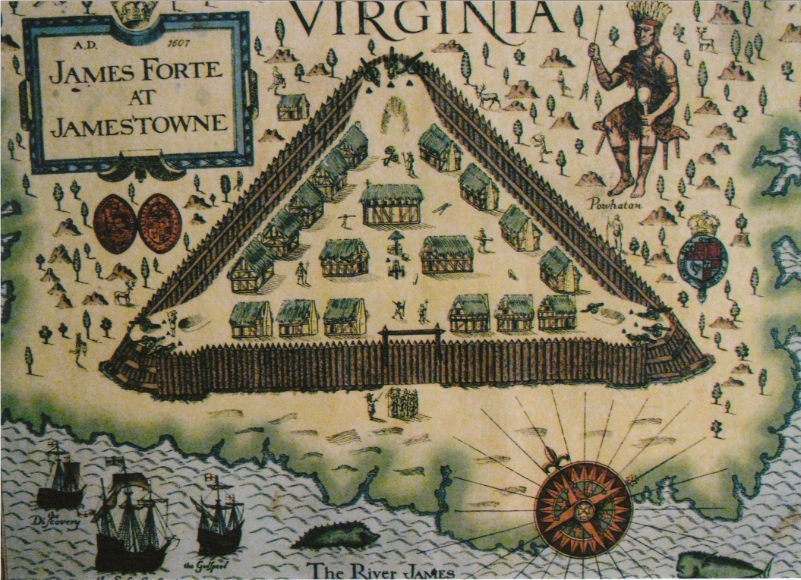
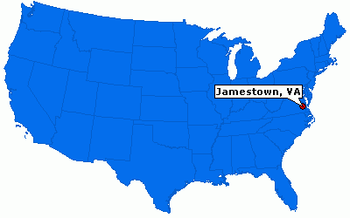
III. The Four Colonial Patterns in North America:
The First Colonial Pattern--Jamestown in Virginia
The first English permanent settlement was founded in 1607 in Jamestown, Virginia (Left). The above picture shows the fort of Jamestown.

Slide 15
Two events that took place in Jamestown that would influence the shaping of American culture
The House of Burgesses
The start of enslavement

Slide 16
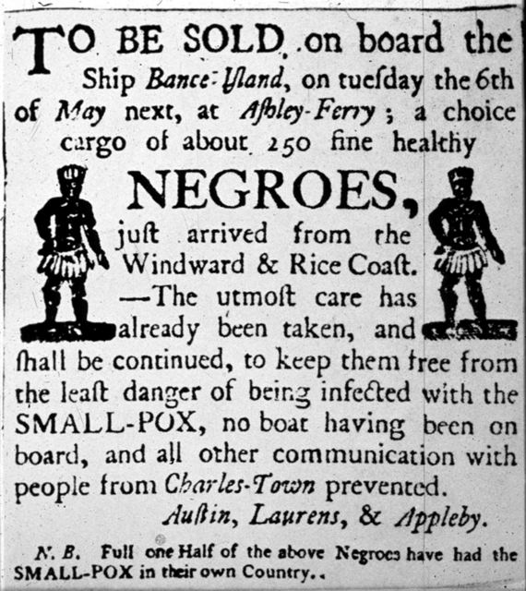
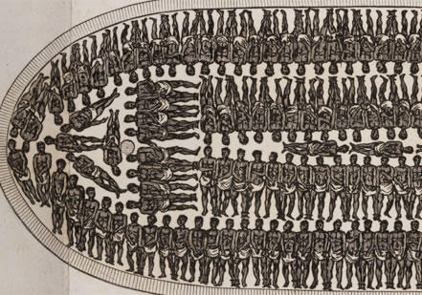
Slave Trade
An advertisement for a slave auction
A slave ship

Slide 17
The Second Colonial Pattern—Puritan New England
Puritanism
God incomprehensible to man;
the power of God being all-knowing;
some people as God’s elect and the success of one’s work or the prosperity in his calling as the sign of being God’s elect;
the Bible as the authority of their doctrine

Slide 18
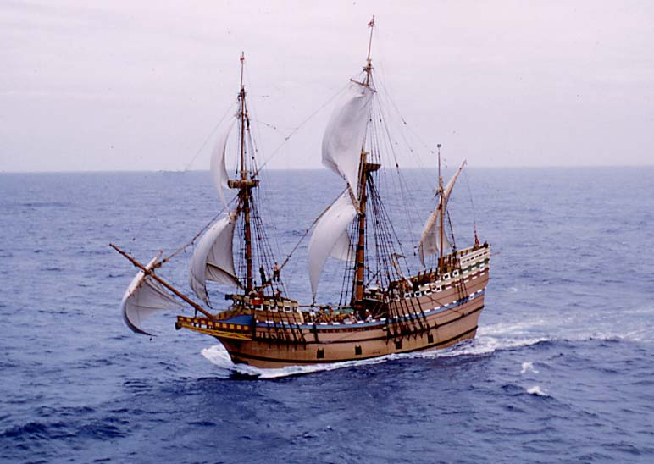
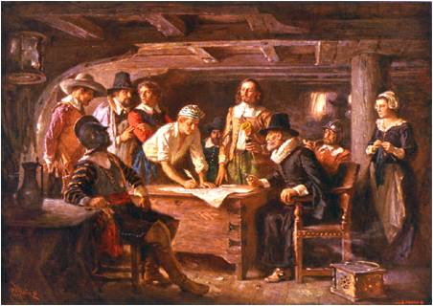
Persecution of Puritans in England and fleeing to Holland
The ship Mayflower
The Mayflower Compact

Slide 19
Puritan Legacies
The notion of building “a city upon hill”—an ideal community, a worthy model for other nations;
Individualism;
Hard work;
Respect of education

Slide 20
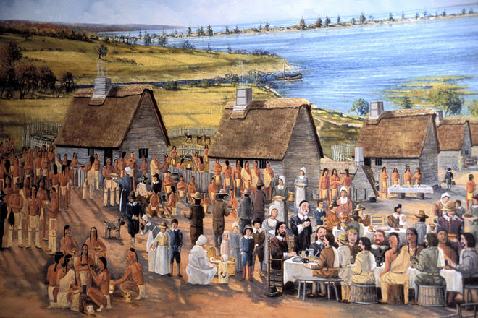
Settlement in Plymouth
Settlement was founded at Plymouth, Massachusetts in 1620

Slide 21
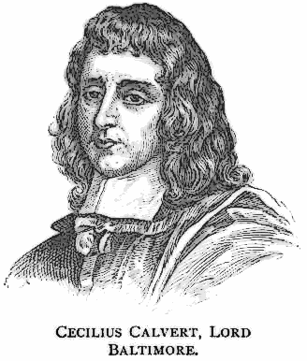
The Third Colonial Pattern—Catholic Maryland
The colony founded by Lord Baltimore (right) in Maryland in 1632;
Baltimore’s experiment to establish a feudal system in the colony;
Failure of his feudal plan

Slide 22
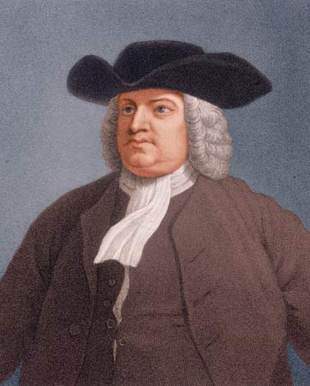
The Fourth Colonial Pattern—Quaker Pennsylvania
In 1681 William Penn (right) used the debt the English king owed to his father to obtain a grant from the king to set up a colony in North America.

Slide 23
Quakerism
Quakers believed in God through their faith without the help of church and priests.
They built no church and trained no priest.
They communicated directly with God.
They lived a simple life and worked hard.
They refused all forms of war and followed a passive resistance.

Slide 24
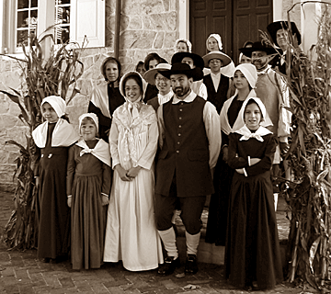
Quakers

Slide 25
Quaker Pennsylvania—the Holy Experiment
Religious freedom for all settlers;
Easy for people to get land;
Encouraging the spirit of equality;
Attracting Germans, French, Irish and English settlers and practicing the idea of the melting-pot;
Electing a representative assembly;
Great impact on American culture

Slide 26
IV. The American Revolution
By the early 1760s, the 13 English colonies in North America had developed a similar American pattern in politics, economy and cultural life—ready to break away from the Old World.
Britain’s victory over France in the Seven Years’ War (French and Indian War) led to a conflict with its American colonies
-new taxes
-Quartering Act
-“No taxation without representation”

Slide 27
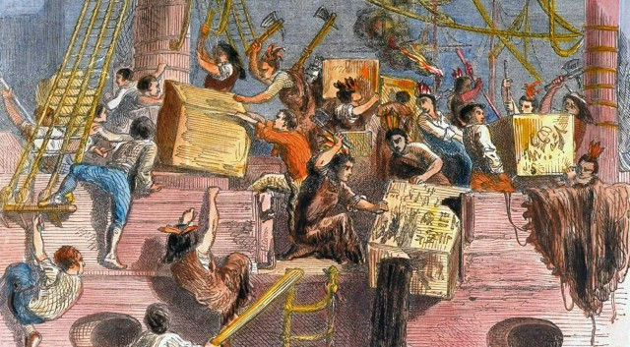
The Boston Tea Party in 1773

Slide 28
The First Continental Congress
The First Continental Congress was held in Philadelphia on September 5, 1774
-to urge Americans to disobey the English “Intolerable Acts”
-to boycott British trade

Slide 29
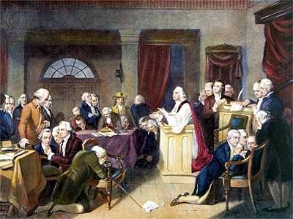
The First Continental Congress in Philadelphia

Slide 30
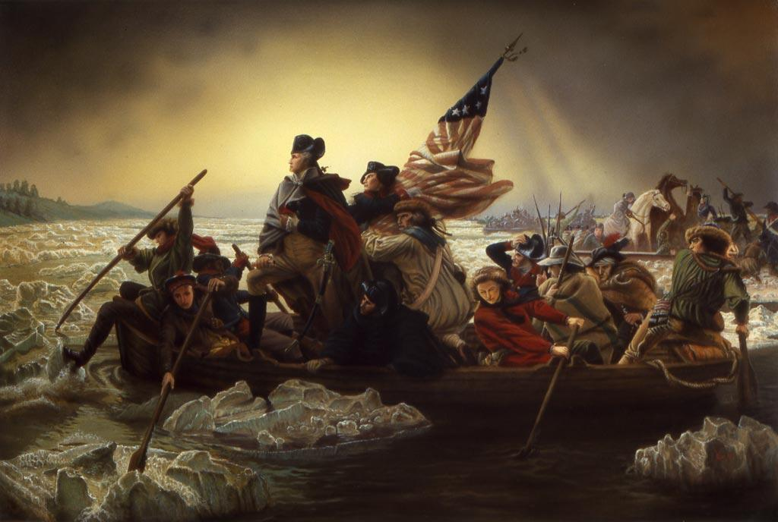
The American War of Independence
The first shot of the war was fired in 1775 in a small town Concord near Boston. Thus the American War of Independence began.

Slide 31
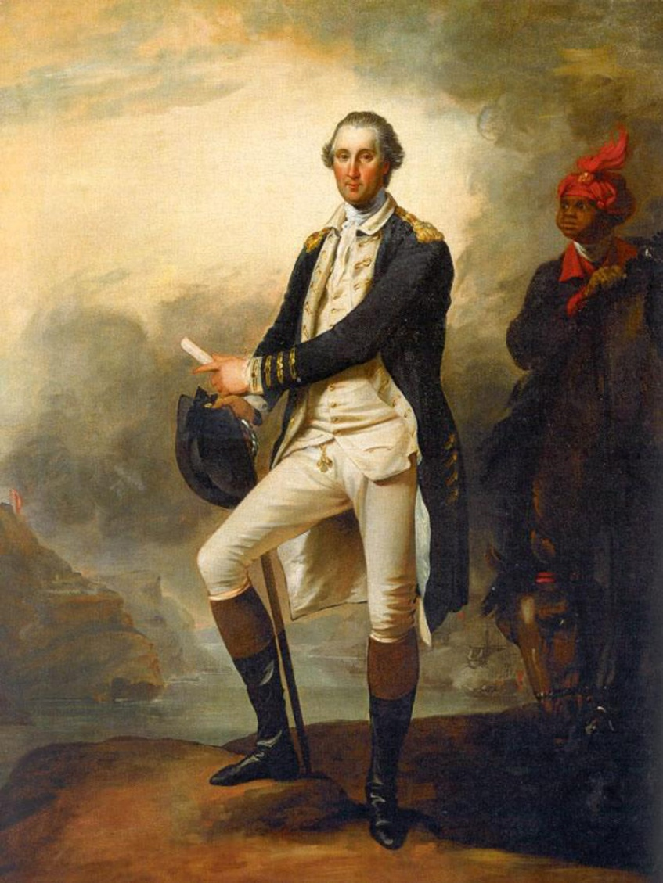
The American Revolution
In1775 the Second Continental Congress met to take on the functions of a national Government; it founded a Continental Army and Navy under the command of George Washington.

Slide 32
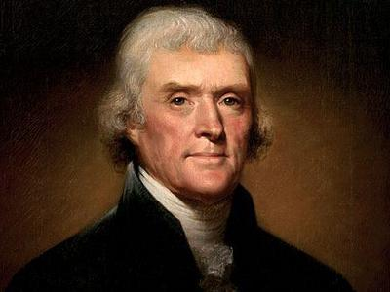
The American Revolution
The Declaration of independence was drafted by Thomas Jefferson (right), assisted by John Adams and Benjamin Franklin. It was adopted by the Second Continental Congress on July 4, 1776, officially proclaiming the independence of the 13 North American colonies.

Slide 33
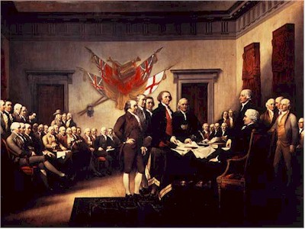
The Signing of the Declaration of Independence
“We hold these truths to be self-evident, that all men are created equal; that they were endowed by their Creator with certain unalienable rights; that among these, are life, liberty and the pursuit of happiness.”—The Declaration of Independence

Slide 34
Questions for Discussion
A. How was the New World related with and, at the same time, different from the Old World?
B. What cultural heritage did the English permanent settlements leave for the future of America?
C. Why did the Catholic Maryland colonial pattern fail while the other patterns thrived?
D. What were the causes of the American War of Independence?

Slide 35
The End
高等教育出版社
2015

